Slide 1
ClickCove - Ecommerce Website
Submitted by: Kartik Arora (2210990486) Jatin Jaglan (2210990458) Kartikey Bartwal (2210990492) Jaskirat Singh (2210990446)
Submitted to: Dr. Baljit Kaur Mr. Vikas Patel

Slide 2
Outline
Introduction
Overview
Key Features
Steps to use it
Live Demo
Responsive Nature
Tech Stack
Objective
References
Conclusion

Slide 3
Introduction
ClickCove | Ecom Website:
Elevating E-Commerce with AI-Powered Recommendations and Filters

Slide 4
Overview
ClickCove stands at the forefront of e-commerce innovation, offering a seamless shopping experience enriched with cutting-edge AI technology.
With a mission to redefine the way users discover and engage with products online, ClickCove integrates sophisticated AI algorithms to deliver personalized recommendations and advanced filtering options, ensuring that every user finds exactly what they need with ease.

Slide 5
Key Features
Visual Search: Allow users to search for products using images rather than text. AI-powered visual search technology can analyze images to identify similar products in your inventory, making the shopping experience more intuitive and convenient.
Sentiment Analysis: Implement sentiment analysis algorithms to analyze customer feedback, reviews, and social media mentions. This helps in understanding customer sentiment, identifying areas for improvement, and enhancing overall customer satisfaction.
Visually looks amazing, has different kinds of components used for accessing the interface

Slide 6
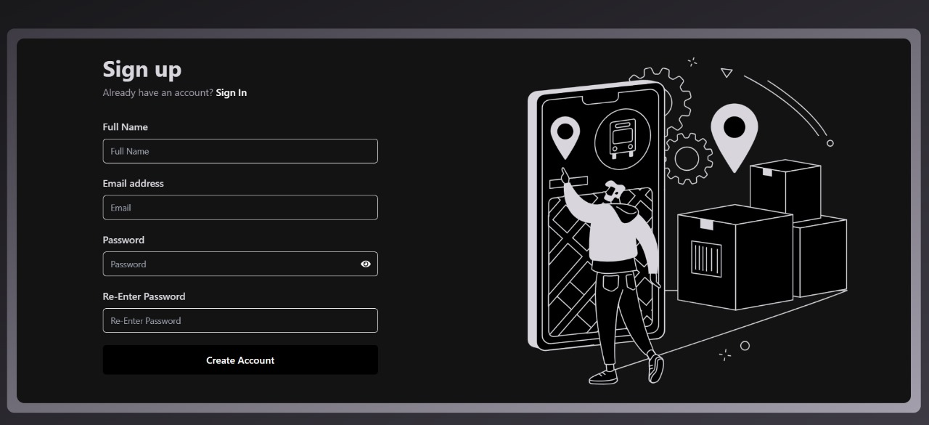
Live Demo
Sign up page : User can login by filling their inputs in the section provided.

Slide 7
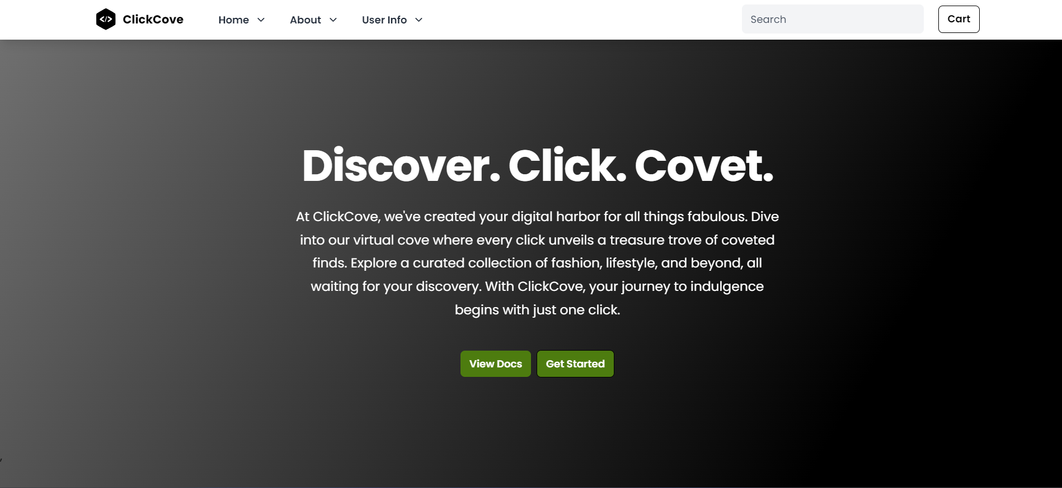
Home Page

Slide 8
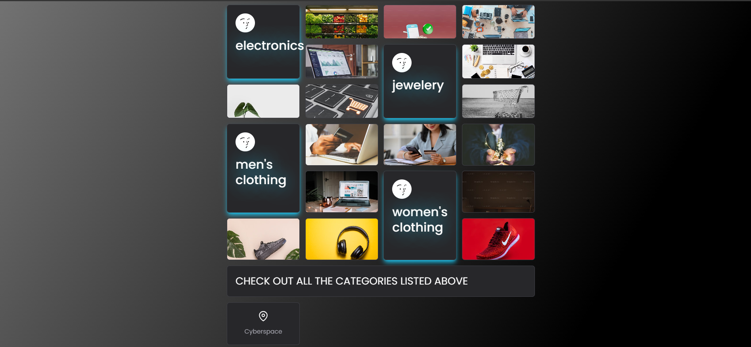
Responsive Nature
Home Page Continued.

Slide 9
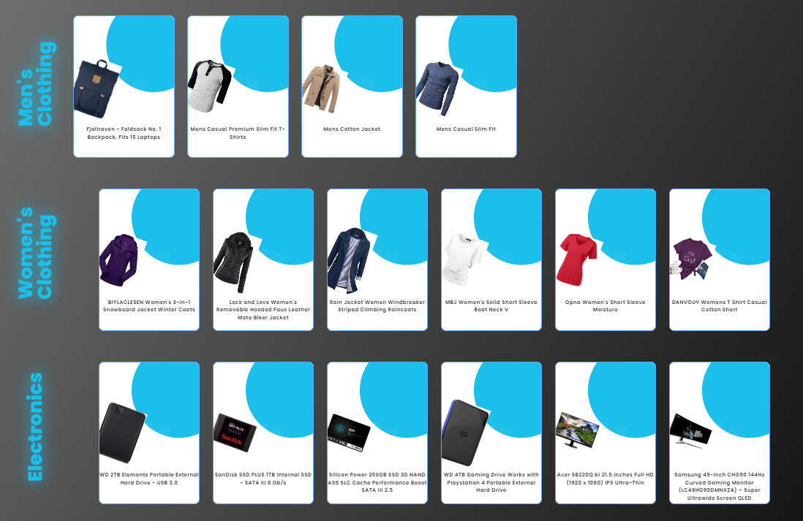
Product Tab

Slide 10
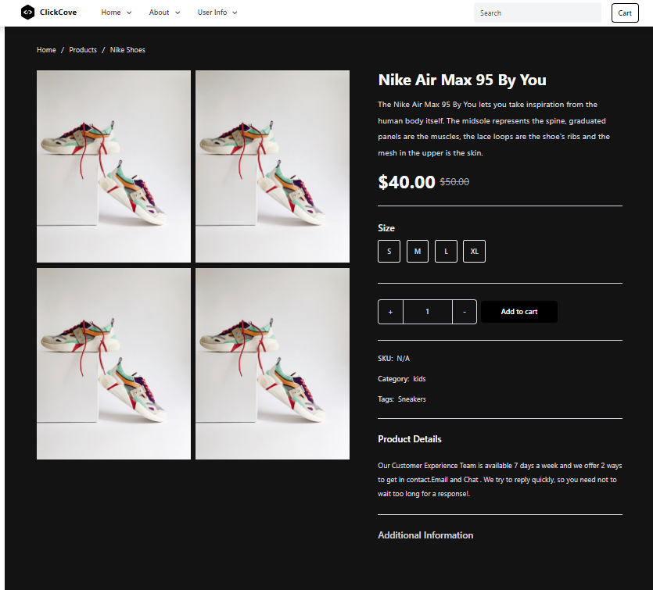
Product Tab

Slide 11
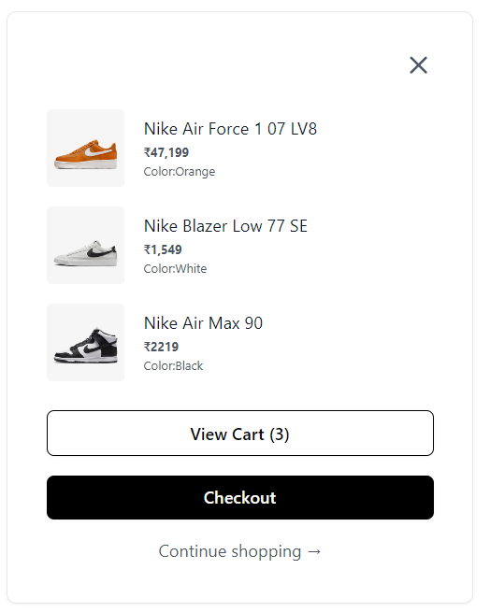
Checkout Feature

Slide 12
Tech Stack
HTML
CSS
JAVASCRIPT
Tailwind
React

Slide 13
Objective
We are in the process of developing an ecommerce platform that provides personalized input and advanced research capabilities tailored to specific target users.
By enabling enhanced customer feedback and review mechanisms, our aim is to bolster overall sales performance.

Slide 14
References
HTML:
Official Documentation: HTML Living Standard
Tailwind CSS:
Official Documentation: Tailwind CSS Documentation
GitHub Repository: Tailwind CSS GitHub
React:
Official Documentation: React Documentation
GitHub Repository: React GitHub
Hover.css (hover.dev):
Official Documentation: Hover.css Documentation
GitHub Repository: Hover.css GitHub
Material-UI:
Official Documentation: Material-UI Documentation
GitHub Repository: Material-UI GitHub

Slide 15
Conclusion
Key Takeaways:
Emphasize the importance of user experience enhancements.
Highlight the significance of increasing conversion rates.
Stress the value of expanding market reach.
Encourage fostering deeper customer engagement.
Advocate for improving operational efficiency.

Slide 16
Thank You

